Slide 1


Ambient Technology
Privacy Policy Parser
Alex Choy | Dhyan Gandhi | Nora Sheeder

Slide 2
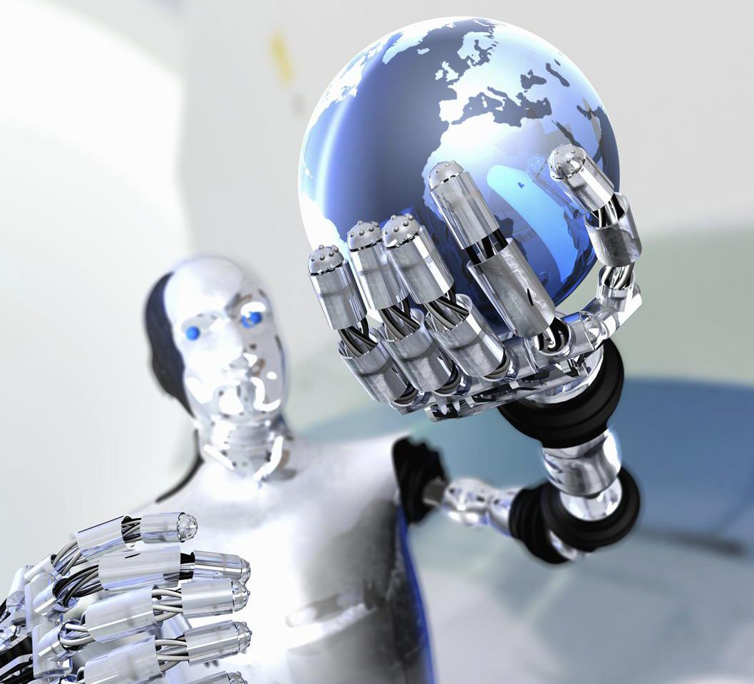
Background
What is Ambient Technology?
Ambient Technology Today?
Notes:
NORA
1 ‘Digital twin’ holds all of your data from real and virtual world. Able to negotiate preferences from temperature to data sharing
1 In the future when data rights are owned by the individual, digital twin will need to be able to negotiate data preferences for individual
2 Ambient Technology and its infrastructure currently does not exist. In order to apply this technology on a large scale, technological and legal advancements are needed
Ex: temperature in a room
Car lanes for preferred pricing
House purchase negotiation
Data examples - video recording in public, location tracking - could lead to taking back control of your data

Slide 3
Our Focus
Privacy Policies
Build model that parses through privacy policies
Output data collection and use
Use case - Ambient Twin
Use case - today
Notes:
Ambient twin - This type of model would be necessary for a digital twin in negotiating the data use of an individual (basically a digital twin needs to understand a privacy policy to negotiate it)
Today - Today this model could be helpful for individuals to better understand what aspects of their privacy and information are being signed away when accepting a privacy policy

Slide 4

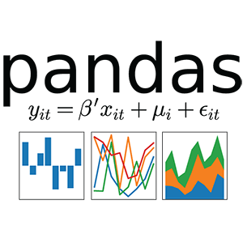






Tools and Libraries

Slide 5
Data
Corpus of 115 privacy policies
Columns
Annotation ID
Annotator ID
Segment ID
Attribute Value Pairs
Date
Batch ID
Policy ID
Category Name
Date
Policy URL
Notes:
Corpus from researchers
Law students read through privacy policy and annotated them
9 columns
1. (A) annotation ID (a globally unique identifier for a data practice)
2. (B) batch ID (name of a batch in the annotation tool; often indicates who the annotators were)
3. (C) annotator ID
4. (D) policy ID (this corresponds to the numeric prefixes in the policy filename, as found in other directories)
5. (E) segment ID (the zero-indexed, sequential identifier of the policy segment; e.g., the first segment in a policy's text is segment zero)
6. (F) category name
7. (G) attribute-value pairs (represented as JSON)
8. (H) policy URL
9. (I) date
Privacy policies from paper “The Creation and Analysis of a Website Privacy Policy Corpus”; privacy policies that had annotation standardized process and were annotated by law students
115 website privacy policies across 15 sectors
Policies are in English for US company
Privacy policy selection based on Google Trends and website sectors

Slide 6
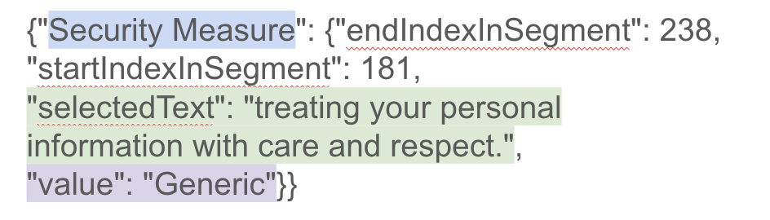
Data
Dataset grouped into 10 major categories
Attribute Value Pairs
Notes:
ALEX
Used the following columns for our models
Category name column
First value - subcategory - more granular than category
Value - most granular version explaining what was in the privacy policy
Selected text - from privacy policy, what we used for our input into our models
Note: for any one text there can be multiple labels on the category, subcategory, and value level

Slide 7

Approaches
DNN and Random Forest to predict 10 categories
Model to predict one of 150 granular labels
Notes:
NORA
1. worked – problems (losing information)
2. Model didn't learn – multiple labels for any one selected text, not enough examples of any one label
Difficulty training model to have multiple labels in DNN, Random Forest
Difficulty navigating dataset to get all relevant info from it

Slide 8
Final Approach
Building 78 models to predict individual categories, subcategories, and values
Utilized Word2Vec and word embeddings
"selectedText": "treating your personal information with care and respect."
"category": "Data Security"
"subcategory": "Security Measure"
"value": "Generic"
Notes:
Model used is neural network

Slide 9
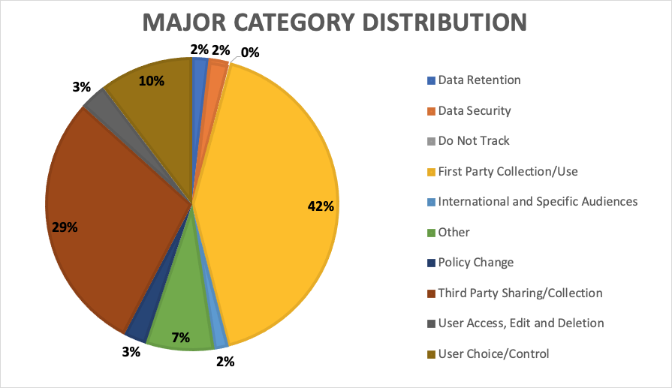

Slide 10
Methodology: Category Models
10 models one for each category
Ran every selected text through every model
If selected text had a category it was labeled 1, if not it was labeled 0
Notes:
Preference for FP over FN

Slide 11
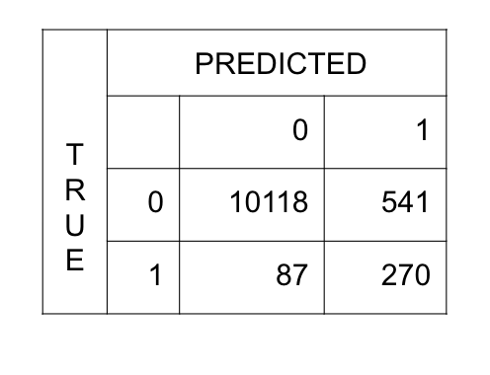
Results: Category Models
Training: F1 Score range (0.2209, 0.9230)
Training: Recall Score range (0.9444, 1.0)
Testing: F1 Score range (0.1405, 0.7568)
Testing: Recall Score range (0.6979, 0.9660)
Min # of Observations: 67
Max # of Observations: 15,346

Slide 12
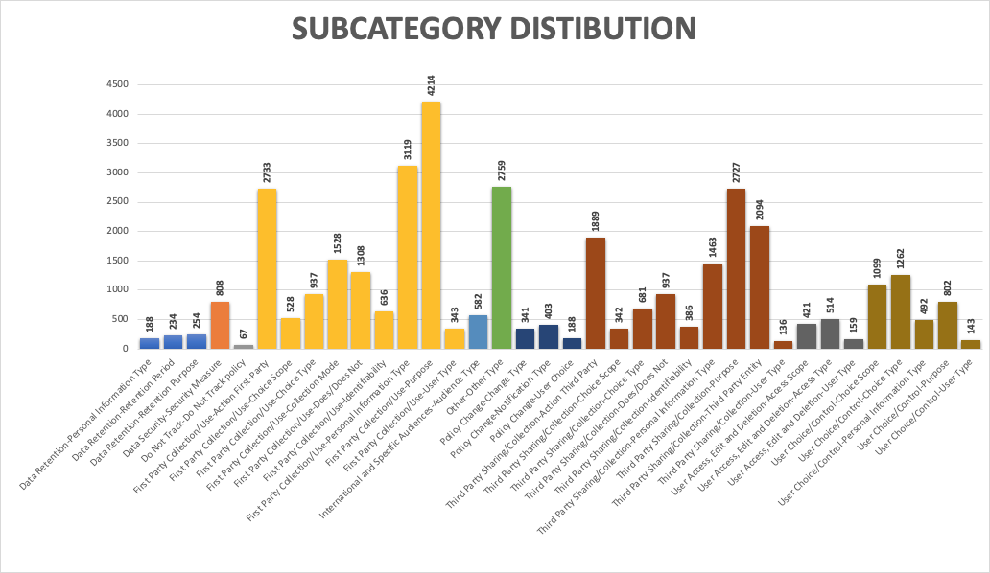

Slide 13
Methodology: Subcategory Models
32 models one for each subcategory
Ran every selected text through all of the subcategories under the major categories they were associated with
If selected text had a category it was labeled 1, if not it was labeled 0
Notes:
Omitted models for subcategories if the category only had one subcategory
Associated with the major category
Classweights, - imbalanced data
dropout and regularizes - overfitting of the data
Binary classification

Slide 14
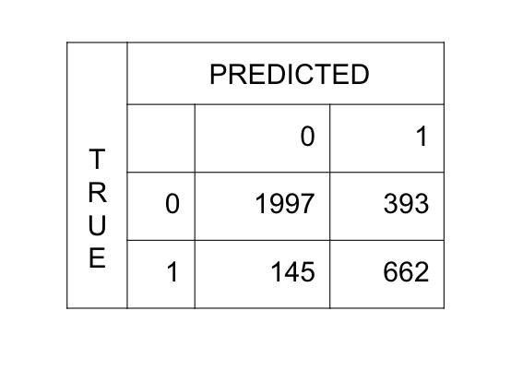
Results: Subcategory Models
Training: F1 Score range (0.1762, 0.9314)
Training: Recall Score range (0.9519, 1.0)
Testing: F1 Score range (0.1360, 0.7819)
Testing: Recall Score range (0.7115, 0.8966)
Min # of Observations: 67
Max # of Observations: 4,214
Notes:
Preference - false pos over false neg

Slide 15
Methodology: Value Models
36 models one for each subcategory
Model ran for all selected texts in any given subcatefory and would output a label for said text
Notes:
NORA
Why didn’t we do so many models
Multiclassification versus binary classification before

Slide 16
Results: Value Models
Training: Accuracy Score range (0.8000, 0.9923)
Testing: Accuracy Score range (0.3380, 0.9466)
Min # of Observations: 1
Max # of Observations: 1,201
Notes:
NORA

Slide 17
Takeaways
Need more data to accurately predict to the granularity
Amount of data in each category, subcategory, and value was skewed
Given a larger and more balanced dataset, our model would have predicted more accurately
Additional work needed
Notes:
2. caused difficultly training models
over/under sampling
Sanitizing the text more and labels since more than one annotator was annotation on one text
Also try RNNs - we could also say it;s one of the many other things we did try

Slide 18
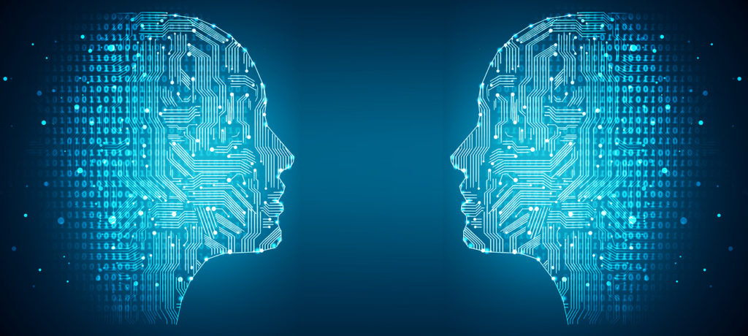
Future Research in Ambient Technology
Model to learn user preference
Model to negotiate user preference and privacy policy
Notes:
DHYAN
Model to learn user preference (given a small amount of information about an individual’s privacy preferences, produce a confidence for any piece of data usage and based on a threshold return to user and continue learning)
Model to negotiate between user preference and privacy policy (instantaneous redlines)
If intel wanted to continue upon the project they would need to build the rest

Slide 19

Questions?
Notes:
Value models – NN with 2 layers – 50 neurons, activation relu and tanh, epochs=10, batchsize=100, learning rate standard in keras(0.001)
Cat/subcat – NN with 1-2 layers – 50 neurons in layers, activation relu and tanh, epochs=5-10, batchsize=100, learning rate standard in keras (0.001)

